Slide 1
HEART DISEASE DIAGNOSTIC ANALYSIS

Slide 2
AGENDA
Objectives
Problem statement
THE PROCESS
Key Performance Indicator (KPI)
INSIGHTS
CONCLUSION

Slide 3
Objectives
The goal of this project is to analyze the heart disease occurrence, based on a combination of features that describes the heart disease.
Which age group has the highest chances of getting heart disease.
Relationship between Chest Pain Severity and Heart Disease.
Do male are more prone to heart disease or female?

Slide 4

Problem Statement
Health is real wealth in the pandemic time we all realized the brute effects of covid-19 on all irrespective of any status. You are required to analyse this health and medical data for better future preparation.

Slide 5
The Process
Data Collection
Data Cleaning
Data Analysis
Insights

Slide 6
Data Collection
The Data has been collected in the form of a csv file named “Heart Disease Data.csv”.
File contains Heart Health data of about 1025 people
It has a columns: age, sex, cp, trestbps, chol, fbs, restecg, thalach, exang, oldpeak, slope, ca, thal and target.

Slide 7
Data Cleaning
Changed the column names to – Age, Gender, CP, RPB(Diastolic), SC, FBS, RER, MHRA, EIA, Oldpeak, Slope, Flourosopy, Thallium Test, HD.
Age – The person’s age in years
Gender – The person’s sex (1 – Male, 0 – Female).
CP – Chest Pain Severity (Value 1: typical angina, Value 2: atypical angina, Value 3: non-anginal pain, Value 4: asymptomatic)
RPB(Diastolic) – Resting Blood Pressure
SC – Serum Cholesterol in mg/dl
FBS – Is Fasting Blood Glucose greater than 120mg (1 = true; 0 = false)

Slide 8
Data Cleaning
RER – Resting Electrocardiographic Results (0 = normal, 1 = having ST-T wave abnormality, 2 = showing probable or definite left ventricular hypertrophy by Estes' criteria)
MHRA – Maximum Heart Rate Achieved
EIA – Exercise Induced Angina (1 = yes; 0 = no)
Oldpeak - ST depression induced by exercise relative to rest
Slope - the slope of the peak exercise ST segment (Value 1: upsloping, Value 2: flat, Value 3: down sloping)
Flourosopy – Number of major vessels coloured by flourosopy (0-3)

Slide 9
Data Cleaning
Thallium Test – To check how well blood flows to the heart muscles. (0-Normal, 1-fixed defect, 2-reversable defect)
HD – Heart Disease ( 0 = No, 1 = Yes)

Slide 10
Data Cleaning
Changed value 0 and 1 of Gender column to Male and Female respectively.
Some columns has outliers. Replaced those values with the median of that column using Python.
Some values of Oldpeak column has value zero, which is not possible in practical situation. It is always greater than zero. So, replaced those zero values with the median of Oldpeak Column.
According to dataset metadata, Thallium Test column should only have values 0,1 and 2. But some rows has value 3, which is incorrect. So,Its replaced all the values of 3 with 2.

Slide 11
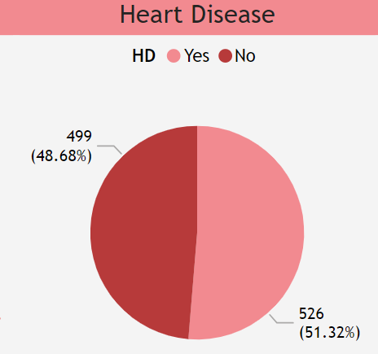
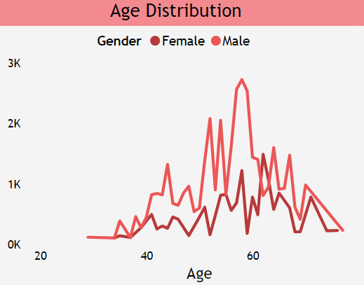
Data Analysis
51.32% People suffering from heart disease.
More men are from age category >50 and females are from category >55

Slide 12
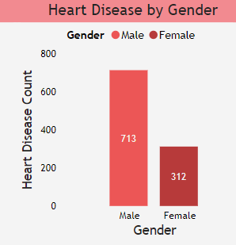
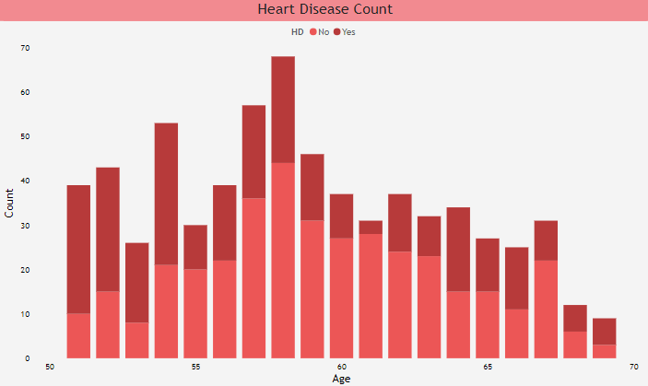
Data Analysis
Males are more prone to Heart Disease
More people are from age category >50 and females are from category >60 are prone to HD

Slide 13
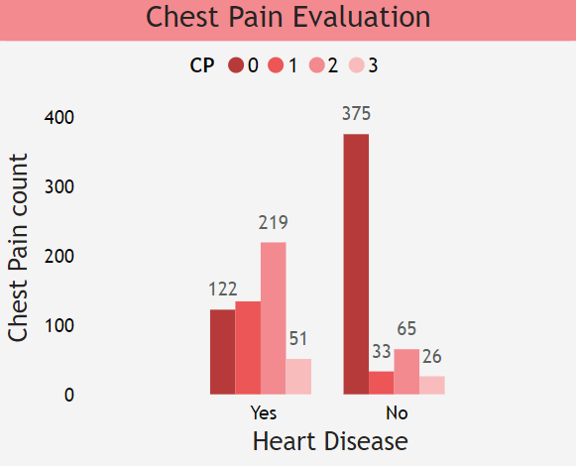
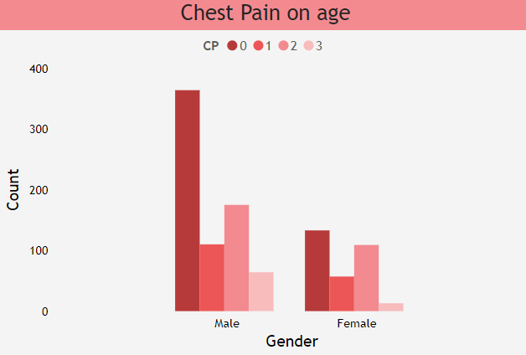
Data Analysis
people having asymptomatic chest pain have a higher chance of heart disease.
Higher number of men are suffering from Asymptomatic type of Chest Pain

Slide 14
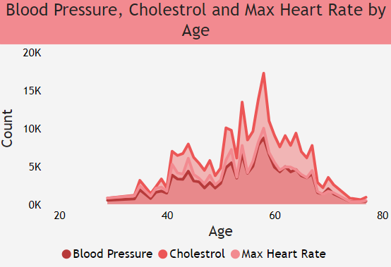
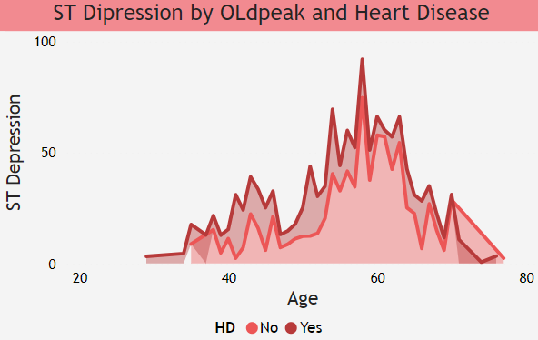
Data Analysis
Here we can observe that Blood Pressure increases between age of 50 to 60 and somehow continue the pattern till 70. Similarly, Cholesterol and maximum heart rate Increasing in the age group of 50-60.
we can observe from here that ST depression mostly increases between the age group of 30-40.

Slide 15
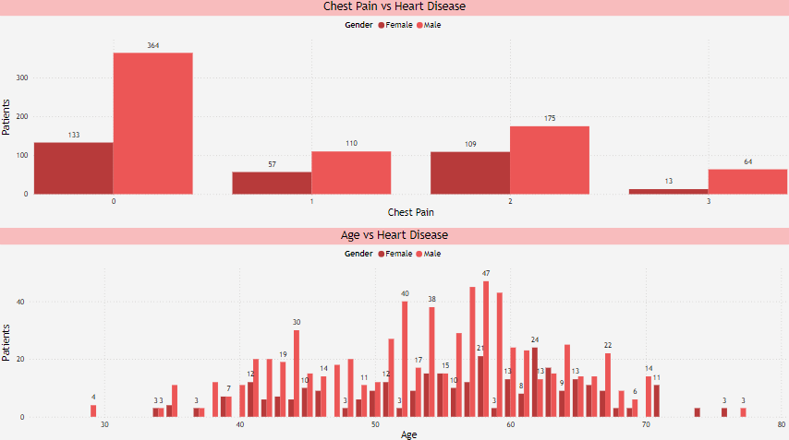
Data Analysis

Slide 16
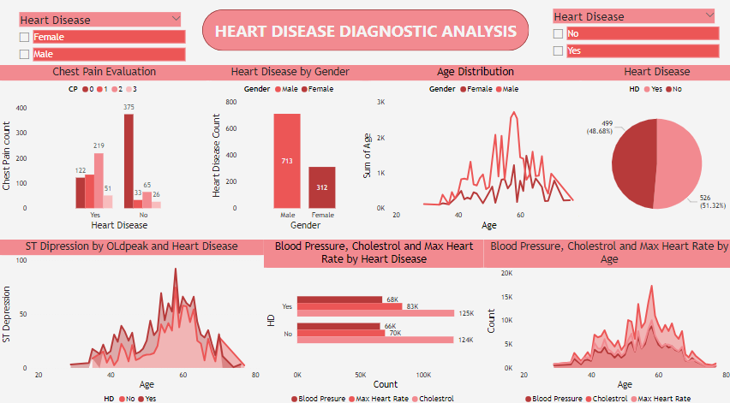
Data Analysis

Slide 17
Key Performance Indicator (KPI)
Percentage of People Having Heart Disease
Age Distribution including Gender
Gender Distribution Based on Heart Disease
Chest Pain Experienced by People Suffering from Heart Disease
Blood Pressure, Cholesterol Level and Maximum Heart Rate of People According to their Age and Heart Disease Patients
ST Depression Experienced by People According to their age and heart disease.

Slide 18
Insights
Total number of patients are 1025 out of which 312 are females and 713 are males.
The average age of patients is 54.
Patients of 48.5% (13% females and 35.5% males) don’t have any kind of Chest Pain.
Only 7.5% patients (77 patients – 13 females and 64 males) have very severe Chest Pain.
Most of the patients between the age of 55 and 65 have the highest Resting Blood Pressure (Diastolic value) which is greater than 150mg/dl. This shows they are more prone to High Blood Pressure.

Slide 19
Insights
A total of 853 patients (267 females and 586 males), approx. 83% patients have Serum Cholesterol(SC) Value greater than 200mg/dl, which increases the risk of Cardiovascular Diseases.
Only 15% patients (42 females and 111 males) have Fasting Blood Sugar levels greater than 120mg/dl. This indicates that they are either prediabetics or have Type-2 Diabetes.
Only 1.5% patients (11 females and 4 males) have Resting Electrocardiographic value of 2, which indicates signs of Heart Attack.
48.5% patients don’t have any kind of cardiac abnormalities.
Male patients have good Resting Electrocardiographic Results as compared to female patients.

Slide 20
Insights
34% of the patients (74 females and 271 males) have Exercise Induced Angina which means they feel chest pain due to the insufficient blood flow to the heart muscle during physical exercise.
390 patients have Oldpeak value of 0.8, which is not severe but have moderate level of ischemia (reduced blood flow to the heart).
47% patients have normal slope value of 1 as compared to 46% patients who have slope value of 2. But 7% patients have a slope value of 0, which shows more severe ischemia or coronary artery diseases.
18 patients (all male) have flourosopy level of 4, which is very critical and requires immediate action. 56% of the patients have flourosopy value of 0, which indicate their heart works fine.

Slide 21
Insights
Around 93% patients have Thallium Test value of 2, which shows decreased blood flow to the heart or even a scar tissue in that region.
Approximately 21% patients (105 females and 114 males) having Chest pain Severity of 2, got diagnosed with Heart Disease. From the chart also we can see that males are more prone to heart diseases.
51% (almost half) of the patients are diagnosed with Heart Disease.
Patients within the age range of 40-45 and 50-60 have shown the signs of Heart Disease.

Slide 22
Conclusion
The 51.32% People suffering from heart disease.
Men are more in 50 to 60 Years and Females are more in 55 to 65 Years Category.
The Males are more prone to heart disease.
Elderly Aged People are more prone to heart disease.
People having asymptomatic chest pain have a higher chance of heart disease.
High number of cholesterol level in people having heart disease.

Slide 23
Conclusion
Blood Pressure increases between age of 50 to 60 and somehow continue till 70.
Cholesterol and maximum heart rate Increasing in the age group of 50-60.
ST depression mostly increases between the age group of 30-40.

Slide 24
THANK YOU

